Slide 1



Java Persistence API
Object Relational Mapping with Java
www.supinfo.com
Copyright © SUPINFO. All rights reserved
Notes:
© SUPINFO International University - http://www.supinfo.com
SUPINFO vous permet de partager ce document
Vous êtes libre de :
Partager — reproduire, distribuer et communiquer ce document Remixer — modifier ce document
A condition de respecter les règles suivantes :
Indication obligatoire de la paternité — Vous devez obligatoirement préciser l’origine « SUPINFO » du document au début de celui-ci de la même manière qu’indiqué par SUPINFO International University – Notamment en laissant obligatoirement la première et la dernière page du document, mais pas d'une manière qui suggérerait que SUPINFO International University vous soutiennent ou approuvent votre utilisation du document, surtout si vous le modifiez. Dans ce dernier cas, il vous faudra obligatoirement supprimer le texte « SUPINFO Official Document » en tête de page et préciser notamment la page indiquant votre identité et les modifications principales apportées.
En dehors de ces dispositions, aucune autre modification de la première et de la dernière page du document n’est autorisée.
NOTE IMPORTANTE : Ce document est mis à disposition selon le contrat CC-BY-NC-SA Creative Commons disponible en ligne http://creativecommons.org/licenses ou par courrier postal à Creative Commons, 171 Second Street, Suite 300, San Francisco, California 94105, USA modifié en ce sens que la première et la dernière page du document ne peuvent être supprimées en cas de reproduction, distribution, communication ou modification. Vous pouvez donc reproduire, remixer, arranger et adapter ce document à des fins non commerciales tant que vous respectez les règles de paternité et que les nouveaux documents sont protégés selon des termes identiques. Les autorisations au-delà du champ de cette licence peuvent être obtenues à support@supinfo.com.
© SUPINFO International University – EDUCINVEST - Rue Ducale, 29 - 1000 Brussels Belgium . www.supinfo.com

Slide 2


Course objectives
JPA
By completing this course, you will:
Understand what JPA is
Learn how to use it

Slide 3

Course topics
JPA
Course’s plan
JPA entity
JPA – advanced functions
JPQL
Good practices

Slide 4
JPA Entity
… or how to manage a database in a transparent way
Notes:
[Title of the course]
Nov 8, 2008
Copyright © 2004-2005 NameOfTheOrganization. All rights reserved.
4

Slide 5


JPA Entity
Preview
This is the contain we'll see
Presentation
Relational database
Entity annotation
Properties annotations
Persistence Unit
JDBC driver
Entity Manager
Entities states
Notes:
[Title of the course]
Nov 8, 2008
Copyright © 2004-2005 NameOfTheOrganization. All rights reserved.
5

Slide 6
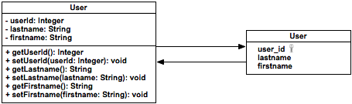
JPA Entity
Presentation
JPA is part of the Java EE platform
Inspired form Frameworks like Hibernate and JDO
Relies heavily on annotation feature
Relationship between objects and tables is done automatically
“object-relational” mapping
Notes:
[Title of the course]
Nov 8, 2008
Copyright © 2004-2005 NameOfTheOrganization. All rights reserved.
6

Slide 7

JPA Entity
Presentation
Necessary items:
A relational database
A JDBC driver as a jar
A xml configuration file for database access
A JavaBean class, which will become a JPA Entity with some annotations
A JPA Entity Manager
Notes:
[Title of the course]
Nov 8, 2008
Copyright © 2004-2005 NameOfTheOrganization. All rights reserved.
7

Slide 8





JPA Entity
Relational database
The majority of relational databases
MySQL
PostGreSQL
Oracle
SQL Server
DB2
…
Notes:
[Title of the course]
Nov 8, 2008
Copyright © 2004-2005 NameOfTheOrganization. All rights reserved.
8

Slide 9

JPA Entity
Entity annotation
A JPA Entity is just a POJO with private properties, getters and setters, default constructor :
public class Contact implements Serializable {
// my properties
private int id;
private String name;
private String firstname;
// ... setters and getters ...
}
Notes:
[Title of the course]
Nov 8, 2008
Copyright © 2004-2005 NameOfTheOrganization. All rights reserved.
9
POJO = Plain Old Java Object

Slide 10

JPA Entity
Entity annotation
… embellished with annotations :
@Entity
public class Contact implements Serializable {
// my properties
@Id
private int id;
private String name;
private String firstname;
// ... setters and getters ...
public int getId(){.....}
}
Notes:
[Title of the course]
Nov 8, 2008
Copyright © 2004-2005 NameOfTheOrganization. All rights reserved.
10

Slide 11

JPA Entity
Entity annotation
@Entity annotation is put on the class : it is used to declare a class as a “JPA Entity”
@Table annotation allows to define the name of the table to which the class is mapped (optional)‏
@Entity
@Table(name="CONTACTS")‏
public class Contact implements Serializable {
}
Notes:
[Title of the course]
Nov 8, 2008
Copyright © 2004-2005 NameOfTheOrganization. All rights reserved.
11

Slide 12

JPA Entity
Properties annotations
@Id annotation is set on the property or on the getter representing the primary key within the database
It’s possible to define how to generate the key with the annotation :
@GeneratedValue(strategy=GenerationType.XXX)‏
The constants proposed are :
IDENTITY
SEQUENCE
TABLE
AUTO
Notes:
[Title of the course]
Nov 8, 2008
Copyright © 2004-2005 NameOfTheOrganization. All rights reserved.
12
IDENTITY = Indicates that the persistence provider must assign primary keys for the entity using database identityc olumn.
SEQUENCE = Indicates that the persistence provider must assign primary keys for the entity using database sequence column.
TABLE = Indicates that the persistence provider must assign primary keys for the entity using an underlying database table to ensure uniqueness.
AUTO = Indicates that the persistence provider should pick an appropriate strategy for the particular database.

Slide 13

JPA Entity
Properties annotations
@Basic
If no specific annotation is declared, this one is used
@Transient
When we do not want to make a property persistent
@Lob
Allows to stock big strings, byte arrays, …
@Temporal
Used to persist dates, hours
@Enumerated
Specify an enumerated field
Notes:
[Title of the course]
Nov 8, 2008
Copyright © 2004-2005 NameOfTheOrganization. All rights reserved.
13

Slide 14




JPA Entity
Persistence Providers
There are different JPA implementations :
The code remains the same, only the configuration file changes
Notes:
[Title of the course]
Nov 8, 2008
Copyright © 2004-2005 NameOfTheOrganization. All rights reserved.
14

Slide 15

JPA Entity
Persistence Unit
The persistence unit is the key element of the JPA Entity technology
It “persists” entities in the database.
Requires a persistence provider and other configurations inside a special file : persistence.xml
Notes:
[Title of the course]
Nov 8, 2008
Copyright © 2004-2005 NameOfTheOrganization. All rights reserved.
15

Slide 16
JPA Entity
Persistence Unit
Configuration file example “src/META-INF/persistence.xml” for Hibernate :
<?xml version="1.0"?>
<persistence xmlns="http://java.sun.com/xml/ns/persistence" version="2.0">
<persistence-unit name="My-PU" transaction-type="RESOURCE_LOCAL">
<provider>org.hibernate.ejb.HibernatePersistence</provider>
<properties>
<property name="javax.persistence.jdbc.driver"
value="com.mysql.jdbc.Driver"/>
<property name="javax.persistence.jdbc.user” value="root"/>
<property name="javax.persistence.jdbc.password” value="root"/>
<property name=”javax.persistence.jdbc.url"
value="jdbc:mysql://localhost:3306/MyDatabase/>
<property name="hibernate.hbm2ddl.auto” value="update"/>
</properties>
</persistence-unit>
</persistence>
Notes:
[Title of the course]
Nov 8, 2008
Copyright © 2004-2005 NameOfTheOrganization. All rights reserved.
16

Slide 17

JPA Entity
JDBC driver
Each database provides a JDBC driver to access it through Java
Depending on the database used, the appropriate JAR should be put in the libraries
Notes:
[Title of the course]
Nov 8, 2008
Copyright © 2004-2005 NameOfTheOrganization. All rights reserved.
17

Slide 18
JPA Entity
Entity Manager
As its name implies, the Entity Manager object will handle all operations on entities : inserting, modifying, deleting them in the database
No SQL code is required, we manipulate Java objects directly :
Country c = new Country("France");
EntityManager em = ...
em.persist(c);
em.close();
Notes:
[Title of the course]
Nov 8, 2008
Copyright © 2004-2005 NameOfTheOrganization. All rights reserved.
18

Slide 19
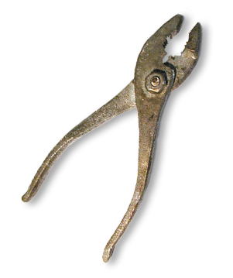
JPA Entity
Entity Manager
Some common operations :
void persist(Object entity)‏
<T> T merge(T entity)‏
void remove(Object entity)‏
<T> T find(Class<T> entityClass, Object primaryKey)
Thanks to them, there is almost no request to write
Notes:
[Title of the course]
Nov 8, 2008
Copyright © 2004-2005 NameOfTheOrganization. All rights reserved.
19

Slide 20
JPA Entity
Entity Manager
How to retrieve it ?
Use an EntityManagerFactory !
EntityManagerFactory emf = null;
emf = Persistence.createEntityManagerFactory(”My-PU");
EntityManager em = emf.createEntityManager();
Contact contact = em.find(Contact.class, 1);
em.close(); emf.close();
Notes:
[Title of the course]
Nov 8, 2008
Copyright © 2004-2005 NameOfTheOrganization. All rights reserved.
20

Slide 21
JPA Entity
Entity Manager
Before any write operation, you should begin a transaction !
EntityManager em = emf.createEntityManager();
EntityTransaction t = em.getTransaction();
try {
t.begin();
...
t.commit();
} finally {
if (t.isActive()) t.rollback();
em.close();
}
Notes:
[Title of the course]
Nov 8, 2008
Copyright © 2004-2005 NameOfTheOrganization. All rights reserved.
21

Slide 22
JPA Entity
Entity Manager
EntityManager objects are not thread safe…
Don’t define one as servlet instance variable !
… but EntityManagerFactory is.
You can use the same instance for all your application
Think to close your EntityManager and EntityManagerFactory object !
Notes:
[Title of the course]
Nov 8, 2008
Copyright © 2004-2005 NameOfTheOrganization. All rights reserved.
22

Slide 23
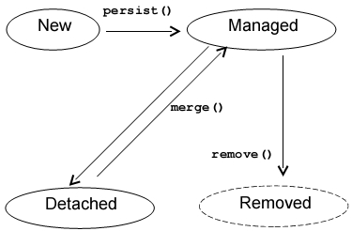

JPA Entity
Entity states
Transient : After the calling of key new
Managed : after the calling of method persist()‏
Detached : when the object is manipulated on the client
Removed : object removed from database
Notes:
[Title of the course]
Nov 8, 2008
Copyright © 2004-2005 NameOfTheOrganization. All rights reserved.
23

Slide 24


JPA Entity
Quiz
Which annotation allows to declare a JPA Entity ?
@Entity
Which annotation allows to declare a primary key?
@Id
How to declare the connection with a Database ?
By deploying a file describing a persistence unit
What is the use of Entity Manager ?
Its methods handles persistence of Entities
Notes:
[Title of the course]
Nov 8, 2008
Copyright © 2004-2005 NameOfTheOrganization. All rights reserved.
24

Slide 25

JPA Entity
Stop-and-think
Do you have any questions ?
Notes:
[Title of the course]
Nov 8, 2008
Copyright © 2004-2005 NameOfTheOrganization. All rights reserved.
25
25

Slide 26
JPA Entity
Exercises (1/3)
Add Hibernate libraries to your project
Add the MySQL JDBC library too
Create a JavaBean class named Category
In a package com.supinfo.supcommerce.entity
With id as Long and name as String
Transform it into a JPA Entity
The table should be named categories
The id field must be the primary key of the table
Create a PersistenceUnit
Notes:
[Title of the course]
Nov 8, 2008
Copyright © 2004-2005 NameOfTheOrganization. All rights reserved.
26

Slide 27
JPA Entity
Exercises (2/3)
Create a JSP page named addCategory.jsp
With a form…
Create a HttpServlet named AddCategoryServlet
Bind it to /auth/addCategory url-pattern
Override the doGet() method
Forward the request to the JSP page
Override the init() method
Create an EntityManagerFactory object
Notes:
[Title of the course]
Nov 8, 2008
Copyright © 2004-2005 NameOfTheOrganization. All rights reserved.
27

Slide 28
JPA Entity
Exercises (3/3)
Create a HttpServlet named AddCategoryServlet
Override the doPost() method
Retrieve the form parameters
Create a new Category object
Set the parameters in the object
Use an EntityManager to persist the object
Override the destroy() method
Close the EntityManagerFactory object
Notes:
[Title of the course]
Nov 8, 2008
Copyright © 2004-2005 NameOfTheOrganization. All rights reserved.
28

Slide 29
JPA – advanced functions
Entities dependencies, inheritance
Notes:
[Title of the course]
Nov 8, 2008
Copyright © 2004-2005 NameOfTheOrganization. All rights reserved.
29

Slide 30

JPA Entity – advanced functions
Preview
This is the contain we'll see
Relationship between Entities
OneToOne
OneToMany and ManyToOne
ManyToMany
Cascading
Lazy loading
Notes:
[Title of the course]
Nov 8, 2008
Copyright © 2004-2005 NameOfTheOrganization. All rights reserved.
30

Slide 31
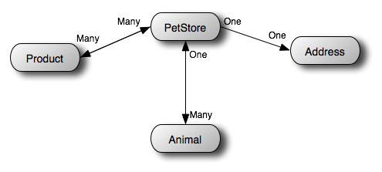
JPA Entity – advanced functions
Relationship between Entities
Entities often have relationships between them :
One-To-One
One-To-Many
Many-To-One
Many-To-Many
Notes:
[Title of the course]
Nov 8, 2008
Copyright © 2004-2005 NameOfTheOrganization. All rights reserved.
31

Slide 32

JPA Entity – advanced functions
Relationship between Entity Beans
Relations between entities are described with annotations put on the property or on the getter
Different strategies are available (foreign keys, join tables)
JPA also handles inheritance relationship between entities with annotations
@
Notes:
[Title of the course]
Nov 8, 2008
Copyright © 2004-2005 NameOfTheOrganization. All rights reserved.
32

Slide 33

JPA Entity – advanced functions
One-To-One
@OneToOne annotation describes a one-to-one relation between two entities.
There are 3 different strategies :
@JoinColumn
a foreign key is used
@PrimaryKeyJoinColumn
2 dependent entities have the same primary key
@JoinTable
a join table contains primary keys
Notes:
[Title of the course]
Nov 8, 2008
Copyright © 2004-2005 NameOfTheOrganization. All rights reserved.
33

Slide 34

JPA Entity – advanced functions
One-To-One
For example, a store entity only has one address :
In the pet store table, a foreign key is used
public class PetStore {
…
@OneToOne
@JoinColumn(name="address_fk")‏
private Address address;
…
}
Notes:
[Title of the course]
Nov 8, 2008
Copyright © 2004-2005 NameOfTheOrganization. All rights reserved.
34

Slide 35

JPA Entity – advanced functions
One-To-Many and Many-To-One
@OneToMany and @ManyToOne annotation link an entity to a collection of another entity
Example :
a person has several bank accounts, and each account has a unique owner
Represented either by a join table or by a column as a foreign key
@JoinTable
@JoinColumn
Notes:
[Title of the course]
Nov 8, 2008
Copyright © 2004-2005 NameOfTheOrganization. All rights reserved.
35

Slide 36

JPA Entity – advanced functions
One-To-Many and Many-To-One
Code example with a pet store selling many animals :
Store entity
Animal entity
A foreign key column is added in the animal table
@OneToMany(mappedBy="petStore")‏
private Collection<Animal>animals;
@ManyToOne
@JoinColumn(name="store_fk")‏
private PetStore petStore;
Notes:
[Title of the course]
Nov 8, 2008
Copyright © 2004-2005 NameOfTheOrganization. All rights reserved.
36

Slide 37

JPA Entity – advanced functions
Many-To-Many
@ManyToMany annotation binds 2 entities with each other
Example :
A product could have many categories and a category contains many products
@JoinTable is the only option
Notes:
[Title of the course]
Nov 8, 2008
Copyright © 2004-2005 NameOfTheOrganization. All rights reserved.
37

Slide 38

JPA Entity – advanced functions
Many-To-Many
How to annote your entities :
Store class
Product class
A join table represents the relationship between stores and products
@ManyToMany
@JoinTable(name="STORE_PRODUCT")‏
private Collection<Product> products;
@ManyToMany(mappedBy="products")‏
private Collection<PetStore> stores;
Notes:
[Title of the course]
Nov 8, 2008
Copyright © 2004-2005 NameOfTheOrganization. All rights reserved.
38

Slide 39

JPA Entity – advanced functions
Cascading
The annotations @OneToOne, @OneToMany, @ManyToOne and @ManyToMany possess the cascade attribute
An operation applied to an entity is reflected to dependent entities
Example : when a user is persisted, so is its accounts.
4 Types : PERSIST , MERGE , REMOVE , REFRESH
CascadeType.ALL : 4 combined

Slide 40

JPA Entity – advanced functions
Cascading
The cascade attribute is set next to the annotation
PetStore entity with an unique address
If the address doesn't exist in database, it is persisted at the same time as the store
public class PetStore {
…
@OneToOne(cascade=CascadeType.PERSIST)‏
@JoinColumn(name="address_fk")‏
private Address address;
…
}

Slide 41

JPA Entity – advanced functions
Lazy loading
The annotations @OneToOne , @OneToMany, @ManyToOne and @ManyToMany possess the fetch attribute
When you retrieve an entity, multi-valued properties are not loaded by default.
Example : when a user is loaded, its accounts are not retrieved.
2 Types : LAZY , EAGER

Slide 42

JPA Entity – advanced functions
Lazy loading
By default, the "lazy" mode is applied for multi-valued properties (List, Set, Map, …)
Change it by putting the fetch property to "eager" on the annotation
When a pet store is retrieved from database, its collection is initialized
public class PetStore {
…
@OneToMany(mappedBy="petStore",
fetch=FetchType.EAGER)‏
private Collection<Animal>animals;
…
}

Slide 43
JPA Entity – advanced functions
Stop-and-think
Do you have any questions ?
Notes:
[Title of the course]
Nov 8, 2008
Copyright © 2004-2005 NameOfTheOrganization. All rights reserved.
43
43

Slide 44
JPA Entity – advanced functions
Exercises (1/2)
Create a JavaBean class named Product
In the package com.supinfo.sun.supcommerce.entity
With the same attributes than SupProduct class
Transform it into a JPA Entity
The table should be named products
The id field must be the primary key of the table
Define a relationship between Product and Category entities
A product can only have one category
A category can have several products
Notes:
[Title of the course]
Nov 8, 2008
Copyright © 2004-2005 NameOfTheOrganization. All rights reserved.
44

Slide 45
JPA Entity – advanced functions
Exercises (2/2)
Update the InsertSomeProductServlet
Replace the SupProduct object by a Product one
Use EntityManager instead of SupProductDao class
Notes:
[Title of the course]
Nov 8, 2008
Copyright © 2004-2005 NameOfTheOrganization. All rights reserved.
45

Slide 46
JPQL
The “object-powered” SQL
Notes:
[Title of the course]
Nov 8, 2008
Copyright © 2004-2005 NameOfTheOrganization. All rights reserved.
46

Slide 47

JPQL
Preview
These are the points we'll see
Presentation
How-to
SELECT request
WHERE clause
DELETE and UPDATE requests
Queries with parameters
Aggregation functions
Named queries
Notes:
[Title of the course]
Nov 8, 2008
Copyright © 2004-2005 NameOfTheOrganization. All rights reserved.
47

Slide 48

JPQL
Presentation
The Entity Manager handles basic CRUD* operations
Java Persistence Query Language makes queries against entities stored in a relational database
It looks a lot like SQL, many requests are available
Instead of working on database tables, it manipulates Java objects transparently
Notes:
[Title of the course]
Nov 8, 2008
Copyright © 2004-2005 NameOfTheOrganization. All rights reserved.
48
CRUD : cread, read, update, delete

Slide 49
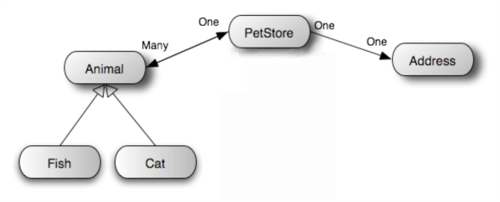
JPQL
Presentation
JPQL manipulates the objects through an internal representation in the Entity Beans container
It is called “abstract schema”
Notes:
[Title of the course]
Nov 8, 2008
Copyright © 2004-2005 NameOfTheOrganization. All rights reserved.
49

Slide 50

JPQL
How-to
To write a request, we need :
An Entity Manager
The JPQL language
A Query object
The Entity Manager is able to create Query objects
The Query is then executed
Notes:
[Title of the course]
Nov 8, 2008
Copyright © 2004-2005 NameOfTheOrganization. All rights reserved.
50

Slide 51
JPQL
SELECT request
Reclaims all entries from an entity table
Obtain an Entity Manager
Create a Query object and then execute it
Query query = em.createQuery("SELECT c FROM Cat AS c");
List<Cat>list = query.getResultList();
Notes:
[Title of the course]
Nov 8, 2008
Copyright © 2004-2005 NameOfTheOrganization. All rights reserved.
51

Slide 52
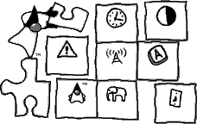
JPQL
WHERE clause
Apply conditions on a request
Some functions
BETWEEN
LIKE
IS NULL
…
Order results with ORDER BY
Query query = em.createQuery(SELECT cat FROM Cat AS cat WHERE cat.animalId = 5");
Cat myCat = (Cat)query.getSingleResult ();
Notes:
[Title of the course]
Nov 8, 2008
Copyright © 2004-2005 NameOfTheOrganization. All rights reserved.
52

Slide 53
JPQL
DELETE and UPDATE requests
Delete entities using JPQL
Update an entity
Query query = em.createQuery("DELETE FROM Cat AS cat WHERE cat.earLength = 2");
int nbrDeleted = query.executeUpdate();
Query query = em.createQuery("UPDATE Cat AS cat SET cat.earLength = 3 WHERE cat.earLength = 4");
int nbrUpdated = query.executeUpdate();
Notes:
[Title of the course]
Nov 8, 2008
Copyright © 2004-2005 NameOfTheOrganization. All rights reserved.
53

Slide 54
JPQL
Queries with parameters
Parameters can be placed in queries
Numeric parameter
String parameter
Query query = em.createQuery("SELECT cat FROM Cat AS cat WHERE cat.animalId = ?1");
query.setParameter(1, 5);
Cat myCat = (Cat)query.getSingleResult ();
Query query = em.createQuery("SELECT cat FROM Cat AS cat WHERE cat.animalId = :id");
query.setParameter("id", 5);
Cat myCat = (Cat)query.getSingleResult ();
Notes:
[Title of the course]
Nov 8, 2008
Copyright © 2004-2005 NameOfTheOrganization. All rights reserved.
54

Slide 55

JPQL
Aggregation functions
Aggregation functions can be used with the SELECT clause
MIN
AVG
COUNT
SUM
…
Example :
Query query = em.createQuery("SELECT MAX(cat.earLength) FROM Cat AS cat");
Number maxEarLength =
(Number) query.getSingleResult();
Notes:
[Title of the course]
Nov 8, 2008
Copyright © 2004-2005 NameOfTheOrganization. All rights reserved.
55

Slide 56
JPQL
Aggregation functions
A special operator allows queries to work trough relationships : IN
Example :
I want to get stores containing the product named « Product »:
Query query = em.createQuery("SELECT s FROM Store AS s, IN(s.products) AS p WHERE p.name = 'Product'");
List<Store> stores =
(List<Store>) query.getResultList();
Notes:
[Title of the course]
Nov 8, 2008
Copyright © 2004-2005 NameOfTheOrganization. All rights reserved.
56

Slide 57
JPQL
Named Queries
It's possible to declare named queries on the entity class
They're precompiled at deployment
How to call them
@Entity
@NamedQuery(name="listBeverages", query="SELECT beverage FROM Beverage AS beverage")
public class Beverage implements Serializable{ … }
Query query = em.createNamedQuery("listBeverages");
…
Notes:
[Title of the course]
Nov 8, 2008
Copyright © 2004-2005 NameOfTheOrganization. All rights reserved.
57

Slide 58
JPQL
Fill in the blanks
JPQL is langage close from
………….
The interest is to manipulate the objects rather than …………
The manipulation of requests is done with the class……..
The majority of SQL functions are still the same.
SQL
tables
Query
Notes:
[Title of the course]
Nov 8, 2008
Copyright © 2004-2005 NameOfTheOrganization. All rights reserved.
58

Slide 59
JPQL
Stop-and-think
Do you have any questions ?
Notes:
[Title of the course]
Nov 8, 2008
Copyright © 2004-2005 NameOfTheOrganization. All rights reserved.
59
59

Slide 60
JPQL
Exercises (1/3)
Replace all your SupProduct objects by Product ones
Use EntityManager instead of SupProductDao class
Think to close them!
Notes:
[Title of the course]
Nov 8, 2008
Copyright © 2004-2005 NameOfTheOrganization. All rights reserved.
60

Slide 61
JPQL
Exercises (2/3)
Create a HttpServlet named CheaperProductsServlet
Override the doGet() method
Retrieve all the products with price < 100
Use JPQL !
Add them as request attributes
Forward the request to listProduct.jsp
Notes:
[Title of the course]
Nov 8, 2008
Copyright © 2004-2005 NameOfTheOrganization. All rights reserved.
61

Slide 62
JPQL
Exercises (3/3)
Update the AddProductServlet
In the doGet() method
Retrieve all categories and put them in request attribute
In the doPost() method
Retrieve the category id in request parameters
Retrieve with it the category from database
Set it inside the product object before persist it
Update the addProduct.jsp page
Add into the form a select field to choose the category
Update the showProduct.jsp page
Display the category name of the product
Notes:
[Title of the course]
Nov 8, 2008
Copyright © 2004-2005 NameOfTheOrganization. All rights reserved.
62

Slide 63
Good Practices
Java Persistence API
DAO & Factory patterns

Slide 64
Good Practices
Data Access Object Pattern
Various methods are available to store information
Relational database
Object-oriented database
Flat files
LDAP
…
If your application change to another method
How to limit impact on the code ?
How to easily evolve the application ?
Solution : add an abstract layer to centralize Data Access
With Data Access Objects
Notes:
[Title of the course]
Nov 8, 2008
Copyright © 2004-2005 NameOfTheOrganization. All rights reserved.
64

Slide 65
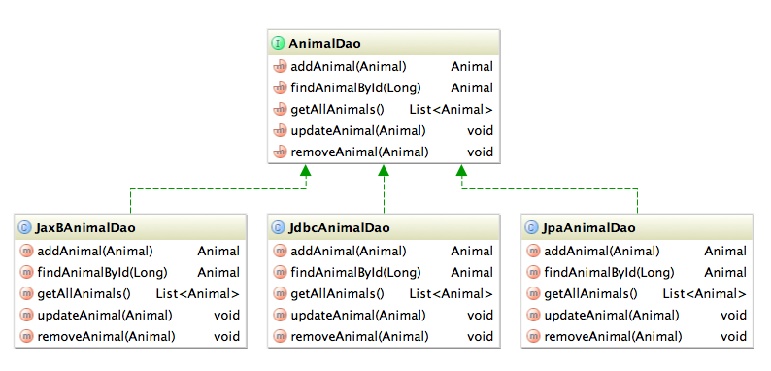
Good Practices
Data Access Object Pattern
One interface define the necessary data access methods
Several different implementations
Notes:
[Title of the course]
Nov 8, 2008
Copyright © 2004-2005 NameOfTheOrganization. All rights reserved.
65

Slide 66
Good Practices
Data Access Object Pattern
How to delete dependency between other classes and DAO implementations ?
Use type inference
Define your variables with the interface type instead of the implementation type
Use a factory to create DAO object
Delegate instance creation in a single point
When you’ll want to change the implementation to use, just modify the factory !
Notes:
[Title of the course]
Nov 8, 2008
Copyright © 2004-2005 NameOfTheOrganization. All rights reserved.
66

Slide 67
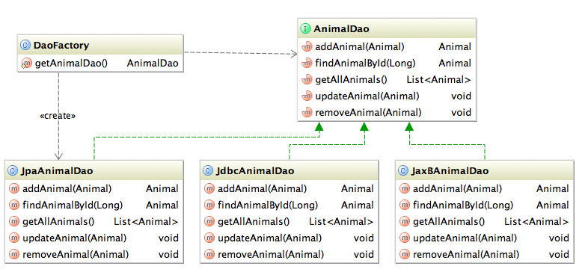
Good Practices
Factory Pattern
Delegate instance creation in a single point
When you’ll want to change the implementation to use
Just modify your factory !
Notes:
[Title of the course]
Nov 8, 2008
Copyright © 2004-2005 NameOfTheOrganization. All rights reserved.
67

Slide 68
Good Practices
Factory Pattern
Example :
public class DaoFactory {
//Private constructor prevent instantiation
private DaoFactory(){}
public static AnimalDao getAnimalDao() {
return new JpaAnimalDao(
PersistenceManager.getEntityManagerFactory());
}
}
Notes:
[Title of the course]
Nov 8, 2008
Copyright © 2004-2005 NameOfTheOrganization. All rights reserved.
68

Slide 69
Good Practices
EntityManagerFactory
Instances are expensive-to-create but thread safe…
How to use only one instance ?
Create its own factory !
How to destroy it when the web application ends ?
Create a ServletContextListener !
Notes:
[Title of the course]
Nov 8, 2008
Copyright © 2004-2005 NameOfTheOrganization. All rights reserved.
69

Slide 70
Good Practices
EntityManagerFactory
Factory example (1/2) :
public class PersistenceManager {
private static EntityManagerFactory emf;
//Private constructor prevent instantiation
private PersistenceManager(){}
// Lazy initialization
public static EntityManagerFactory getEntityManagerFactory(){
if(emf == null){
emf = Persistence.createEntityManagerFactory(“My-PU”);
}
return emf;
}
...
Notes:
[Title of the course]
Nov 8, 2008
Copyright © 2004-2005 NameOfTheOrganization. All rights reserved.
70

Slide 71
Good Practices
EntityManagerFactory
Factory example (2/2) :
...
public static void closeEntityManagerFactory() {
if(emf != null && emf.isOpen()) emf.close();
}
}
Notes:
[Title of the course]
Nov 8, 2008
Copyright © 2004-2005 NameOfTheOrganization. All rights reserved.
71

Slide 72
Good Practices
EntityManagerFactory
ServletContextListener example (1/2) :
public class PersistenceAppListener
implements ServletContextListener {
// Call on application initialization
public void contextInitialized(ServletContextEvent evt){
// Do nothing
}
// Call on application destruction
public void contextDestroyed(ServletContextEvent evt) {
PersistenceManager.closeEntityManagerFactory();
}
}
Notes:
[Title of the course]
Nov 8, 2008
Copyright © 2004-2005 NameOfTheOrganization. All rights reserved.
72

Slide 73
Good Practices
EntityManagerFactory
ServletContextListener example (2/2) :
Or in Servlet 3.0 :
<web-app>
...
<listener>
<listener-class>
com.supinfo.myapp.listener.PersistenceAppListener
</listener-class>
</listener>
...
</web-app>
@WebListener
public class PersistenceAppListener implements ... {
Notes:
[Title of the course]
Nov 8, 2008
Copyright © 2004-2005 NameOfTheOrganization. All rights reserved.
73

Slide 74
Good Practices
Exercises (1/5)
Create a new package
Name it com.supinfo.supcommerce.util
Create one class inside
Name it PersistenceManager
Define a static method which return always the same instance of EntityManagerFactory
Define a static method to close this factory instance
Notes:
[Title of the course]
Nov 8, 2008
Copyright © 2004-2005 NameOfTheOrganization. All rights reserved.
74

Slide 75
Good Practices
Exercises (2/5)
Create a new package
Name it com.supinfo.supcommerce.listener
Create one class inside
Name it PersistenceAppListener
Implements ServletContextListener
In the contextDestroyed(…) method
Close your EntityManagerFactory instance
Declare your new listener in web.xml file or with the good Servlet 3.0 annotation
Notes:
[Title of the course]
Nov 8, 2008
Copyright © 2004-2005 NameOfTheOrganization. All rights reserved.
75

Slide 76
Good Practices
Exercises (3/5)
Create a new package
Name it com.supinfo.supcommerce.dao
Create two new interfaces inside
Name the first one ProductDao
Define all the data access methods you need to manage Product entities
Name the second one CategoryDao
Define all the data access methods you need to manage Category entities
Notes:
[Title of the course]
Nov 8, 2008
Copyright © 2004-2005 NameOfTheOrganization. All rights reserved.
76

Slide 77
Good Practices
Exercises (4/5)
Create a new package
Name it com.supinfo.supcommerce.dao.jpa
Create two new classes inside
Name the first one JpaProductDao
Implements ProductDao interface
Define a constructor with an EntityManagerFactory parameter
Name the second one JpaCategoryDao
Implements CategoryDao interface
Define a constructor with an EntityManagerFactory parameter
Notes:
[Title of the course]
Nov 8, 2008
Copyright © 2004-2005 NameOfTheOrganization. All rights reserved.
77

Slide 78
Good Practices
Exercises (5/5)
Create a class DaoFactory
Inside com.supinfo.supcommerce.dao package
Define a private constructor
Define two methods
One which return a new instance of ProductDao
Another one which return a new instance of CategoryDao
Use your DAO instead of EntityManager in your Servlets !
Notes:
[Title of the course]
Nov 8, 2008
Copyright © 2004-2005 NameOfTheOrganization. All rights reserved.
78

Slide 79
Good Practices
Summary
We need to manage transaction manually
We need to create DAO Factories
We need to use a factory to create EntityManagers
We need to close manually all our EntityManager instance
We need to close manually our EntityManagerFactory
Preferably during application shutdown
Ok, great…
Do you want an easier way to use JPA ?
Use EJB ;-)
Notes:
[Title of the course]
Nov 8, 2008
Copyright © 2004-2005 NameOfTheOrganization. All rights reserved.
79
We’ll see EJB next year !

Slide 80

Course summary
JPA
Define a JavaBean as an Entity
Use the EntityManager to manage entities
Define relationship between entities
Make queries with JPQL
What is DAO and Factory Pattern

Slide 81


JPA
For more
If you want to go into these subjects more deeply, …
Publications
Java Persistence et Hibernate
Anthony Patricio
Available on http://librairies.supinfo.com
http://library.supinfo.com/BookDetails.aspx?type=cyberlibris&docid=40001058
Web sites
http://java.sun.com/developer/technicalArticles/J2SE/Desktop/persistenceapi/
http://java.sun.com/blueprints/corej2eepatterns/Patterns/DataAccessObject.html
http://javanotepad.blogspot.com/2007/05/jpa-entitymanagerfactory-in-web.html

Slide 82


The end
Servlets

